Slide 1
8. New Research and Application Fields

Slide 2
Main Contents
Data warehouse
OLAP
Data mining
Information retrieval
Semistructured data and XML

Slide 3
8.3 Information Retrieval
A research field traditionally separate from Databases
  Goes back to IBM, Rand and Lockheed in the 50’s
  G. Salton at Cornell in the 60’s
  Lots of research since then
Products traditionally separate
  Originally, document management systems for libraries, government, law, etc.
  Gained prominence in recent years due to web search

Slide 4
IR vs. DBMS
Seem like very different beasts:
Both support queries over large datasets, use indexing.
  In practice, you currently have to choose between the two.
IR | DBMS
Imprecise Semantics | Precise Semantics
Keyword search | SQL
Unstructured data format | Structured data
Read-Mostly. Add docs occasionally | Expect reasonable number of updates
Page through top k results | Generate full answer

Slide 5
IR’s “Bag of Words” Model
Typical IR data model:
  Each document is just a bag (multiset) of words (“terms”)
Detail 1: “Stop Words”
  Certain words are considered irrelevant and not placed in the bag
  e.g., “the”
  e.g., HTML tags like <H1>
Detail 2: “Stemming” and other content analysis
  Using English-specific rules, convert words to their basic form
  e.g., “surfing”, “surfed” --> “surf”

Slide 6
Boolean Text Search
Find all documents that match a Boolean containment expression:
  “Windows”
  AND (“Glass” OR “Door”)
  AND NOT “Microsoft”
Note: Query terms are also filtered via stemming and stop words.
When web search engines say “10,000 documents found”, that’s the Boolean search result size (subject to a common “max # returned’ cutoff).

Slide 7
Text “Indexes”
When IR folks say “text index”…
  Usually mean more than what DB people mean
In our terms, both “tables” and indexes
  Really a logical schema (i.e., tables)
  With a physical schema (i.e., indexes)
  Usually not stored in a DBMS
    Tables implemented as files in a file system
    We’ll talk more about this decision soon

Slide 8
A Simple Relational Text Index
Create and populate a table
  InvertedFile(term string, docURL string)
Build a B+-tree or Hash index on InvertedFile.term
  Alternative 3 (<Key, list of URLs> as entries in index) critical here for efficient storage!!
    Fancy list compression possible, too
  Note: URL instead of RID, the web is your “heap file”!
    Can also cache pages and use RIDs
This is often called an “inverted file” or “inverted index”
  Maps from words -> docs
Can now do single-word text search queries!

Slide 9
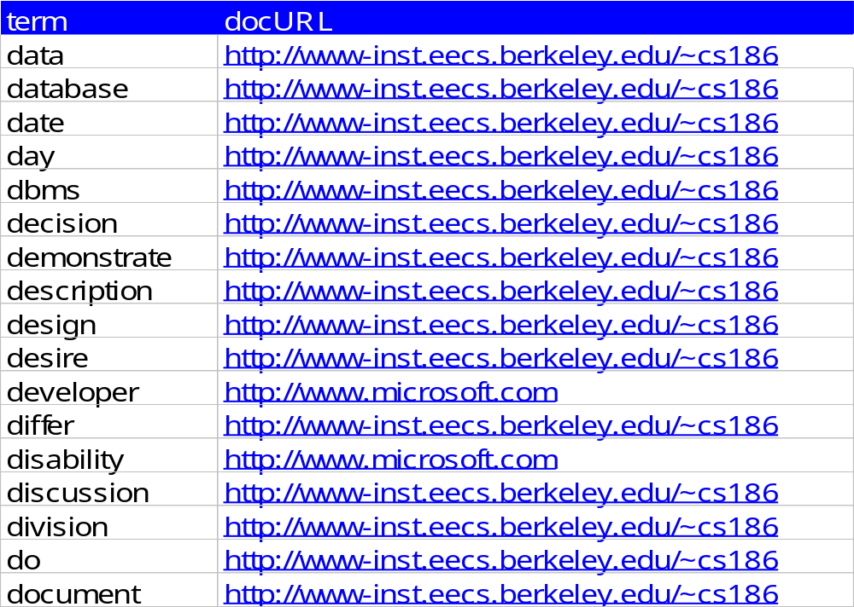
An Inverted File
Search for
  “databases”
  “microsoft”

Slide 10
Handling Boolean Logic
How to do “term1” OR “term2”?
  Union of two DocURL sets!
How to do “term1” AND “term2”?
  Intersection of two DocURL sets!
    Can be done by sorting both lists alphabetically and merging the lists
How to do “term1” AND NOT “term2”?
  Set subtraction, also done via sorting
How to do “term1” OR NOT “term2”
  Union of “term1” and “NOT term2”.
    “Not term2” = all docs not containing term2. Large set !!!
  Usually not allowed!
Refinement: What order to handle terms if you have many ANDs/NOTs?

Slide 11
Boolean Search in SQL
“Windows” AND (“Glass” OR “Door”)
AND NOT “Microsoft”
( SELECT docURL FROM InvertedFile
WHERE word = “windows”
INTERSECT
SELECT docURL FROM InvertedFile
WHERE word = “glass” OR word = “door”)
EXCEPT
SELECT docURL FROM InvertedFile
WHERE word=“Microsoft”
ORDER BY relevance()

Slide 12
Boolean Search in SQL
Really only one SQL query in Boolean Search IR:
  Single-table selects, UNION, INTERSECT, EXCEPT
relevance () is the “secret sauce” in the search engines:
  Combos of statistics, linguistics, and graph theory tricks!
  Unfortunately, not easy to compute this efficiently using typical DBMS implementation.

Slide 13
Computing Relevance
Relevance calculation involves how often search terms appear in doc, and how often they appear in collection:
  More search terms found in doc → doc is more relevant
  Greater importance attached to finding rare terms
Doing this efficiently in current SQL engines is not easy:
  “Relevance of a doc wrt a search term” is a function that is called once per doc the term appears in (docs found via inv. index):
    For efficient fn computation, for each term, we can store the # times it appears in each doc, as well as the # docs it appears in.
    Must also sort retrieved docs by their relevance value.
    Also, think about Boolean operators (if the search has multiple terms) and how they affect the relevance computation!
  An object-relational or object-oriented DBMS with good support for function calls is better, but you still have long execution path-lengths compared to optimized search engines.
Notes:
wrt --- with respect to

Slide 14
Fancier: Phrases and “Near”
Suppose you want a phrase
  E.g., “Happy Days”
Different schema:
  InvertedFile (term string, count int, position int, DocURL string)
  Alternative 3 index on term
Post-process the results
  Find “Happy” AND “Days”
  Keep results where positions are 1 off
    Doing this well is like join processing
Can do a similar thing for “term1” NEAR “term2”
  Position < k off

Slide 15
Updates and Text Search
Text search engines are designed to be query-mostly:
  Deletes and modifications are rare
  Can postpone updates (nobody notices, no transactions!)
    Updates done in batch (rebuild the index)
  Can’t afford to go off-line for an update?
    Create a 2nd index on a separate machine
    Replace the 1st index with the 2nd!
  So no concurrency control problems
  Can compress to search-friendly, update-unfriendly format
Main reason why text search engines and DBMSs are usually separate products.
  Also, text-search engines tune that one SQL query to death!

Slide 16
DBMS vs. Search Engine Architecture
DBMS
Search Engine
Query Optimization
and Execution
Search String Modifier
Ranking Algorithm
Relational Operators
“The Query”
}
{
Simple
DBMS
Files and Access Methods
The Access Method
OS
Buffer Management
Buffer Management
Disk Space Management
Disk Space Management
Concurrency
and
Recovery
Needed

Slide 17
IR vs. DBMS Revisited
Semantic Guarantees
  DBMS guarantees transactional semantics
    If inserting Xact commits, a later query will see the update
    Handles multiple concurrent updates correctly
  IR systems do not do this; nobody notices!
    Postpone insertions until convenient
    No model of correct concurrency
Data Modeling & Query Complexity
  DBMS supports any schema & queries
    Requires you to define schema
    Complex query language hard to learn
  IR supports only one schema & query
    No schema design required (unstructured text)
    Trivial to learn query language

Slide 18
IR vs. DBMS, Contd.
Performance goals
  DBMS supports general SELECT
    Plus mix of INSERT, UPDATE, DELETE
    General purpose engine must always perform “well”
  IR systems expect only one stylized SELECT
    Plus delayed INSERT, unusual DELETE, no UPDATE.
    Special purpose, must run super-fast on “The Query”
    Users rarely look at the full answer in Boolean Search

Slide 19
Lots More in IR …
How to “rank” the output? I.e., how to compute relevance of each result item w.r.t. the query?
  Doing this well / efficiently is hard!
Other ways to help users paw through the output?
  Document “clustering”, document visualization
How to take advantage of hyperlinks?
  Really cute tricks here!
How to use compression for better I/O performance?
  E.g., making RID lists smaller
  Try to make things fit in RAM!
How to deal with synonyms, misspelling, abbreviations?
How to write a good web crawler?
Notes:
wrt --- with respect to

